Slide 1
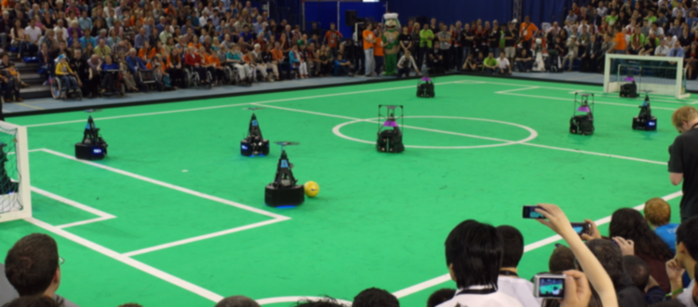
2023 MSD Final Presentation: Assistant Referee
22/03/2024
Department of Mathematics and Computer Science, EngD. Mechatronic Systems Design

Slide 2
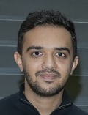
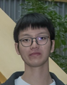
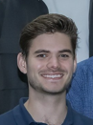
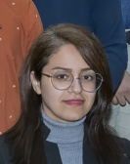
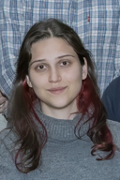
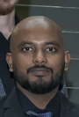
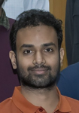
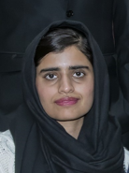
MSD GROUP 2023
Kareem
Ghedan
Joseph
Tandio
Quinten
Swaan
Mahsa
Barghi Mehmandari
Team
Leader
System
Architect
Project
Manager
Scrum
Master
Design
Engineer
Design
Engineer
Design
Engineer
Design
Engineer
Deniz
Akyazi
Anshid
Pillat
Arjun
Chauhan
Naheed
Tabassum
Design
Engineer
Design
Engineer
Design
Engineer
Design
Engineer

Slide 3
Agenda
Goal: Final Delivery of the Project
Problem Definition
User Needs, Project Scope and Requirements
Project Risks
System Overview
Implementation
Integration and Validation
Challenges and Future Work
Question Answer Session
12:00 – 12:05
12:05 – 12:08
12:08 – 12:09
12:10 – 12:12
12:12 – 12:14
12:14 – 12:25
12:25 – 12:40
12:40 – 12:45
12:45 – 13:00

Slide 4
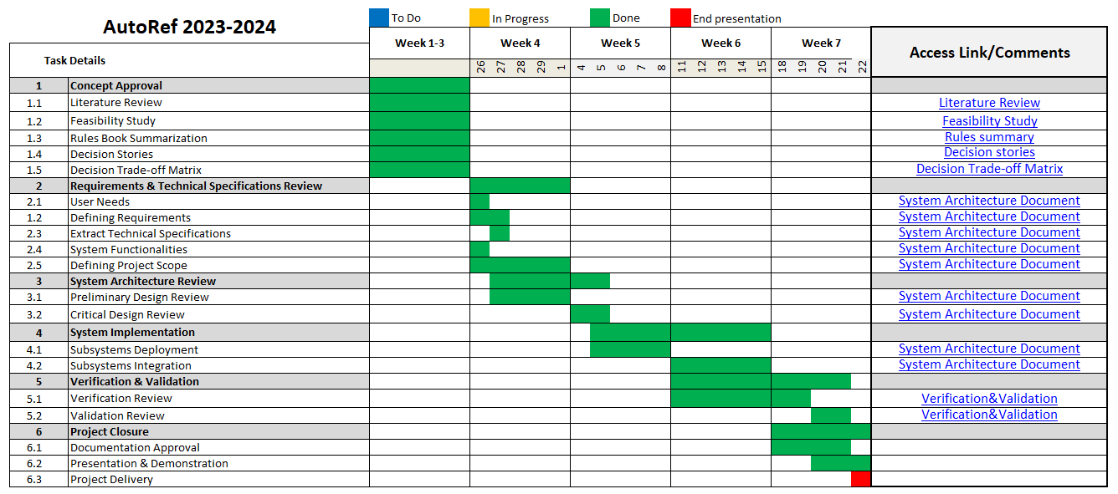
Planning

Slide 5
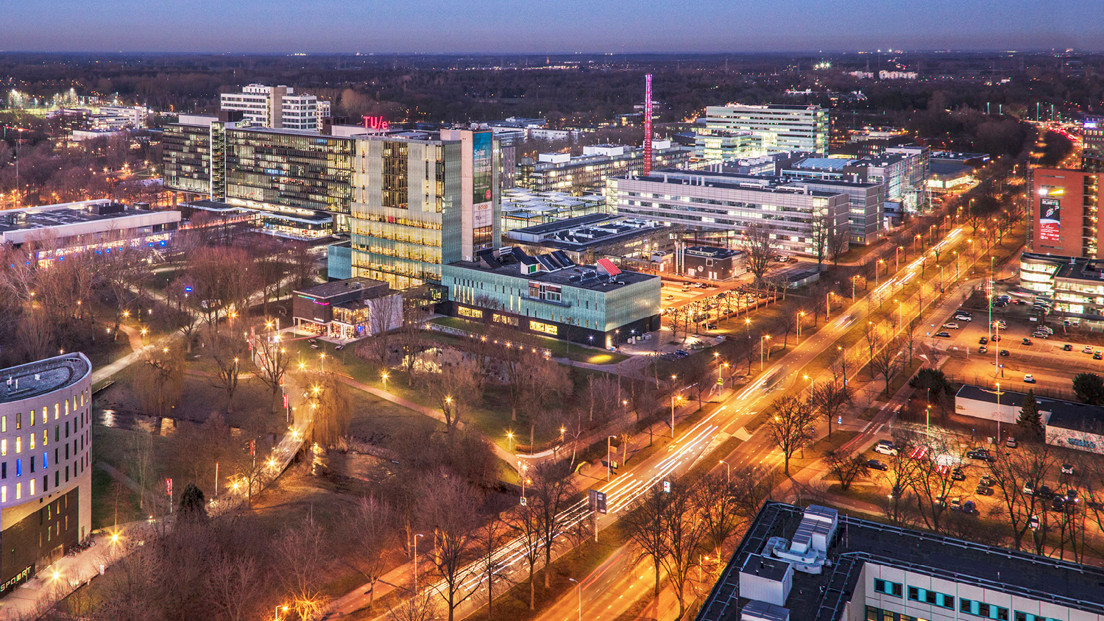
Problem Definition

Slide 6
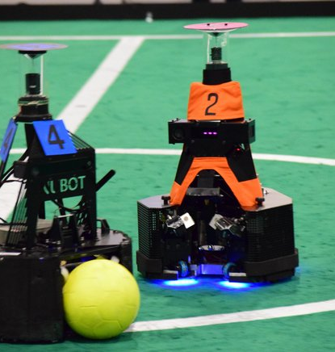



Problem Definition
Autonomous Referee for MSL Soccer Robot Matches
Make Crucial Decisions
Avoid Bias
Assist Human Referee for difficult rules
Enhance Accuracy and Reduce Occurrence of Errors
Implementing RoboCup Rules

Slide 7
User Needs, Project Scope and Requirements

Slide 8
User Needs
Robustness
Adaptability
Performance
Progress
Follow RoboCup MSL rules
Accurate
Real-time
Objectivity
Continuity
Consistent decisions
Safety
Showing proof
Communication
Interests
Challenging
Sending decisions
Personal learning goals

Slide 9
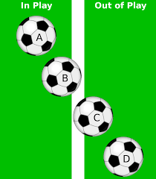
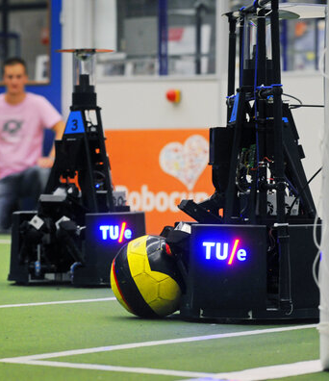

Project Scope
Project Scope
Last Touch
Communication
Ball Out of Play
Notes:
Deniz?

Slide 10
Requirements
01 | AssistRef can make combined decision (out of field and last touch) on real-time (when an event occurred within 1 second).
02 | AssistRef can distinguish which team touched the ball last time when the whole ball is out of field with desired accuracy at least as good as human, 70% correct decision.
03 | AssistRef must have at max distance error between ball and line of ±1.5 cm.
04 | AssistRef must receive data from independent sensor (not from any sensor in competing team robots)
05 | AssistRef must be able to communicate its decision process when needed.
06 | AssistRef must ensure operational time of 2 hours.
Notes:
switch

Slide 11
Project Risks

Slide 12
Project Risks
Legend
Low
Edge cases
Medium
Occurrence
Integration
Sensing accuracy
High
Validation and verification
Trust
Bias
Severity

Slide 13
System Overview

Slide 14

System Overview
Sensor: OptiTrack Vision-Based Motion Capture System
Subsystems:
Ball Out of Play
Last Touch
User Interface
Integration:
Subsystems
Validation:
Requirements fulfillment
Notes:
Deniz?

Slide 15
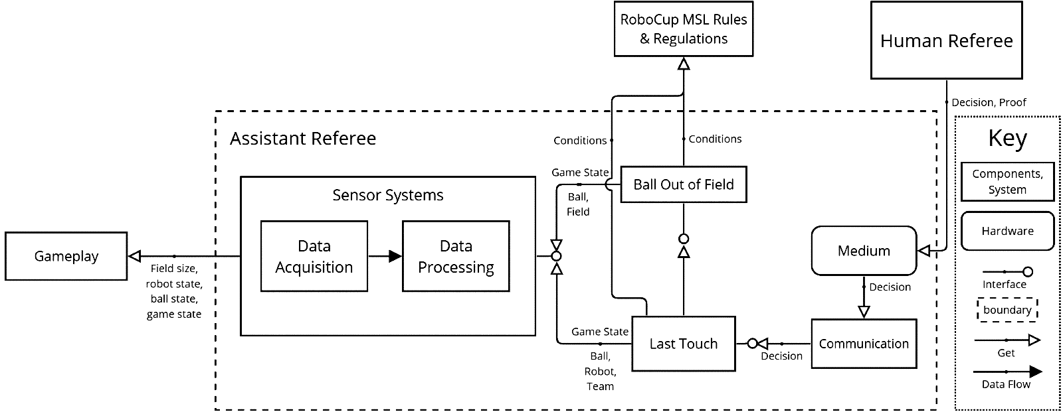
System Operational Diagram
Notes:
Deniz?

Slide 16
Implementation

Slide 17
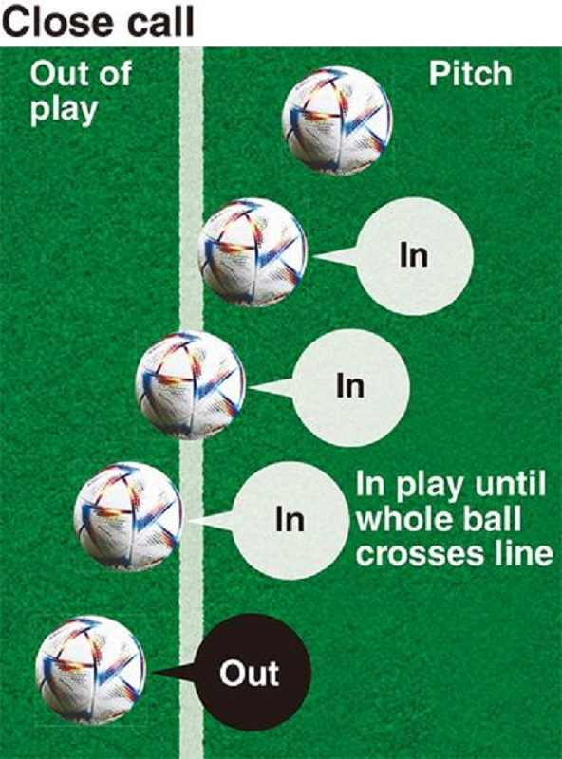
Ball out of play
OptiTrack
Ball center point
Assistant
Referee
Rules
Ball radius
Ball in/out play
Calibration
Line coordinates

Slide 18
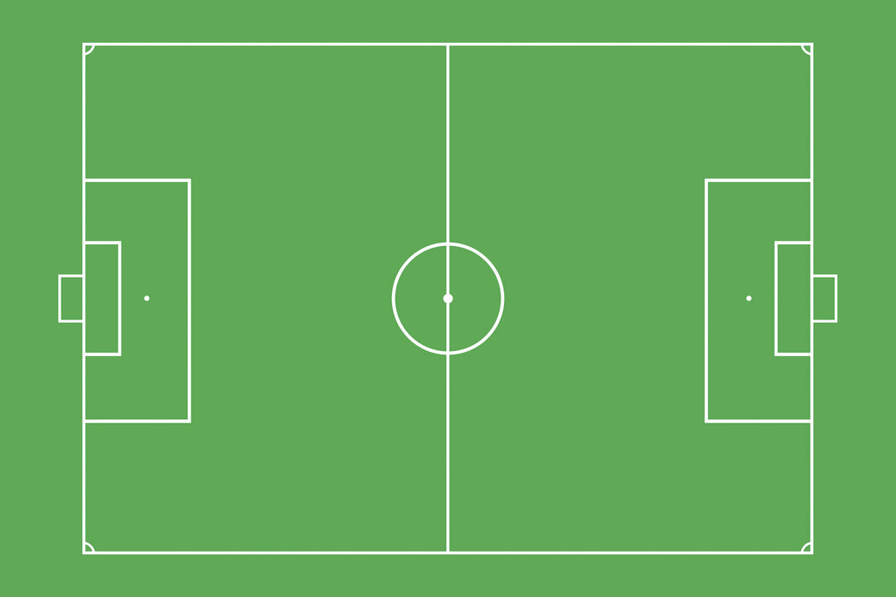
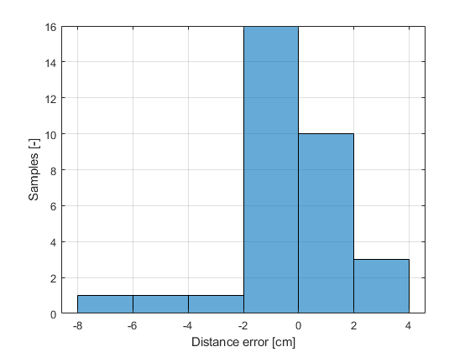
Ball out of play- Verification
Requirement
AssistRef must have a maximal distance error between the ball and the line of ±1.5 cm.
Ground truth location of ball vs system location of ball
Different velocities
Error within -1.26 ± 5.96 cm with 95% confidence interval
Requirement is not met!

Slide 19
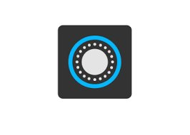
Last Touch
Data Acquisition
Data Preprocessing
Feature Engineering
Split Dataset.
Model Selection
Performance Evaluation
Missing Values
Duplicated Values
Labeling
X-dist
Y-dist
Z-dist
Distance
Training Set: 64%
Validation Set: 16%
Test Set: 20%
SVM
MLP
Decision Tree
Random Forest
Accuracy
Precision
Recall
F1-Score
Robot | Ball
Static | Static
Static | Dynamic
Dynamic | Dynamic
Set | Acc | Classes | Precision | Recall | F1-Score
Validation Set | 92% | No Touch | 0.93 | 0.94 | 0.93
 |  | Touch | 0.90 | 0.88 | 0.89
Test Set | 90% | No Touch | 0.95 | 0.91 | 0.93
 |  | Touch | 0.81 | 0.89 | 0.84
Notes:
Deniz?

Slide 20
Last Touch
Set | Acc | Classes | Precision | Recall | F1-Score
Support Vector Machine
Test Set | 88% | No Touch | 0.92 | 0.91 | 0.91
 |  | Touch | 0.79 | 0.82 | 0.81
Decision Tree
Test Set | 82% | No Touch | 0.91 | 0.82 | 0.87
 |  | Touch | 0.68 | 0.82 | 0.74
Multi-Layer Perceptron
Test Set | 87% | No Touch | 0.92 | 0.89 | 0.91
 |  | Touch | 0.77 | 0.84 | 0.80
Random Forest
Test Set | 89% | No Touch | 0.95 | 0.89 | 0.92
 |  | Touch | 0.79 | 0.90 | 0.84
Notes:
Deniz?

Slide 21
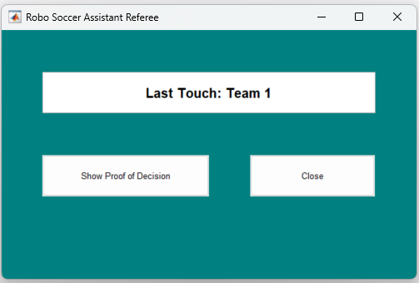
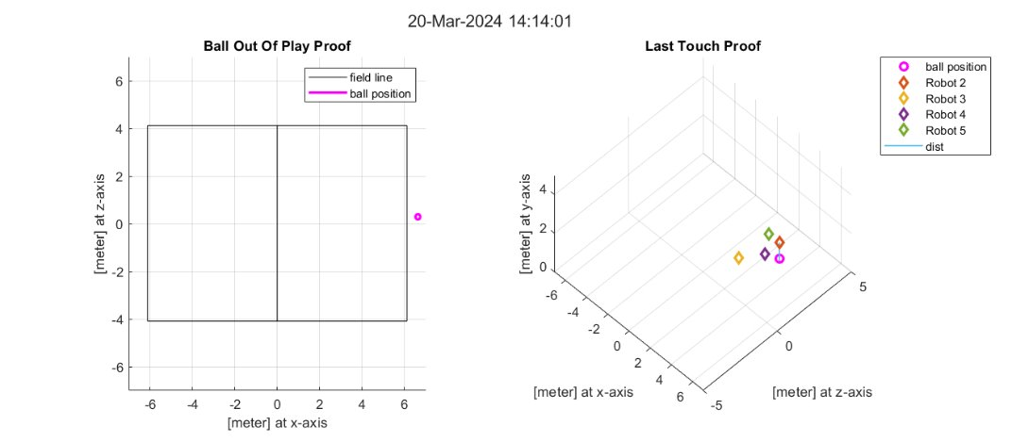

UI for Communicating Last Touch
“Show proof of decision” will show the proof and closes the window
“Close” will close the window

Slide 22
Integration and Validation
Notes:
In this section, I will discuss how we've integrated the subsystems explained by my teammate as well as how we validated this system, including our results and findings.

Slide 23
Integration
Main Algorithm
Referee
Input
OptiTrack
Decision Algorithm
Touch Detection
User Interface
Decision
Proof
BOOP
Works real-time
Has a complete decision flow
Can be readily used
Continuous decision making
Game play/pause
Livestream
Notes:
The main algorithm of the system utilizes two types of information as input. The game situation from the referee, in other words if the game is paused or played through UI, and the location of ball and robots from optitrack through a livestream.
The system then investigates these inputs to come up with two factors in its final decision: if the ball is out of play/field and if the ball is touched by any robot.
Making these investigations, the system finally decides: if the ball is out of play, which team last touched it by tracking back the touch data and their corresponding timestamps.
Finally, through a user interface, the system shows its decision to the referee, and if asked, it shows the proof as well.
One big advantage of our system is that it can be readily used in the matches taking place in tech united field currently, it utilizes the real-time data and has a complete flow of decision making. Also, the system continues getting input and making decisions once the referee give the input to it about game continue.

Slide 24
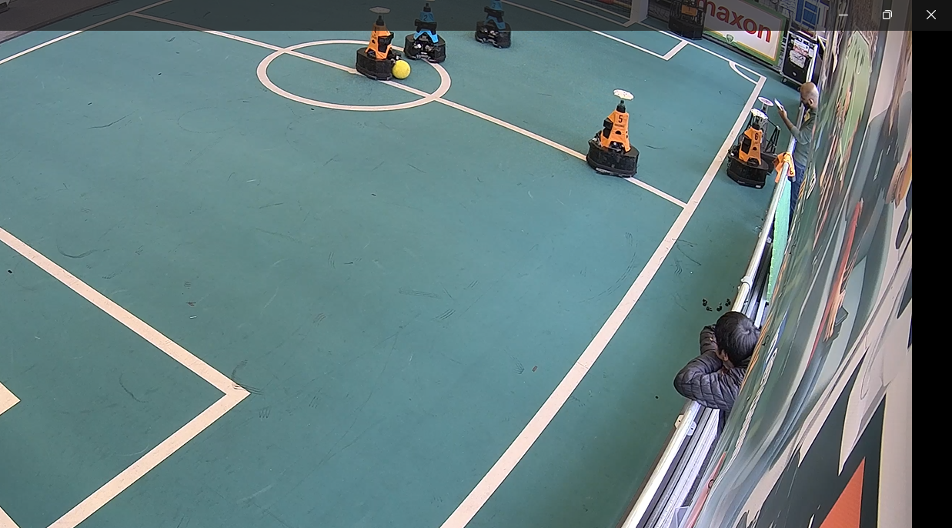
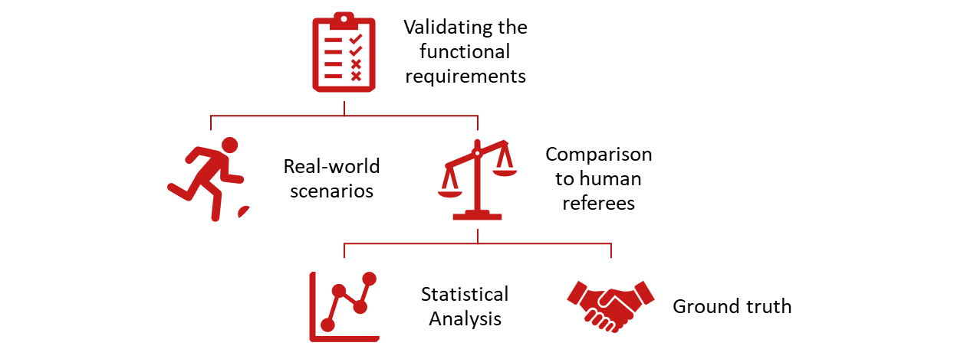
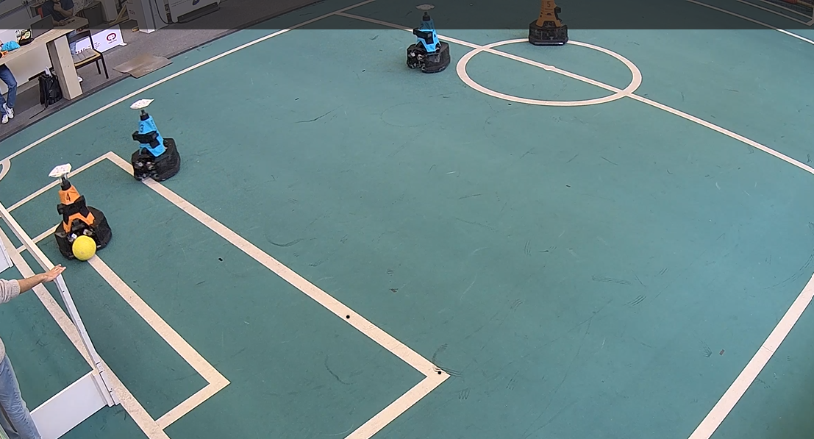
Validation
Samples collected: 46 (3 edge cases)
Overall: 80.4% accuracy with 73% confidence interval.
F1 Score: 0.89
Human referee: 97.8% overall accuracy
*1 case out of 46, system detected a ball out of play which wasn't detected by the human referee
 |  | Actual
 |  | Blue | Orange
Predicted | Blue | 33 | 3
 | Orange | 4 | 4
System reaction time was <1 second in average.
Notes:
We have utilized the tech united field to validate our system through 2 vs 2 example matches between robots. We've invited human referees and used our system at the same time.
We've recorded decisions made by the human referees and our system to be used for analysis. During these matches, we didn't have a conflict between human referee decisions. For having a ground truth, since we didn't want to base it on neither our system's or human referees' decision, we've recorded the matches with surveillance cameras from different angles and investigated the results through them. There also wasn't a conflicting decision.
Our system showed better than 1 second decision time in average which fulfilled our requirement.
As for the results, we collected 46 samples where 3 of them were edge cases. For defining the edge cases, we took the feedback of referees, asking them the cases where it was difficult for them to make a decision.
Overall, our system showed 80.4% accuracy with a confidence interval of 73%. We've created a confusion matrix by looking at where actual decision should be and what our system decided and calculated an F1 score of 0.89 which was considered decent from our angle.
The accuracy of multiple human referees during our validation matches were 97.8%. This showed that our current system isn't better than combined decision of multiple referees. Our system made correct decision in 2 out of 3 edge cases during validation, but unfortunately 3 samples are too little to make a certain conclusion. We wanted the validation to be as close to as a real match possible so we didn't manipulate the robots in the matching process, resulting in less edge cases.
In one case out of 46 though, our system detected a ball out of play which wasn't detected by the human referees.
Unfortunately, we had some limitations during our validation. The optitrack's sensor system wasn't covering the whole field. As seen from the images, it went approximately as far as the red lines drawn. This resulted in two scenarios, firstly our system couldn't detect the location of robots or the ball while they were in that area and considered they stayed in their last detected location. Secondly, we had to discard all cases when the ball was out of field when it wasn't in the detected area. Also, in some cases, if any robot was out of detection, this created a wrong decision for our system.
One important remark I would like to make is, we defined an output of last touch was done by both teams. With the combination of optitrack's limitation, this also created wrong results in 3 cases. Two examples where the last touch was happening is shown in these images.
In summary, this validation showed us that although our system is still lacking to be used as a stand-alone referee for last touch, it can assist the referee when it is hard to make a decision with its proof system.

Slide 25
Demo Video
Video removed in presentation to save GitHub storage space
Notes:
Now, let us watch a demo video prepared by our team. Now, my teammate will present you the rest of our work.

Slide 26
Challenges and Future Work

Slide 27
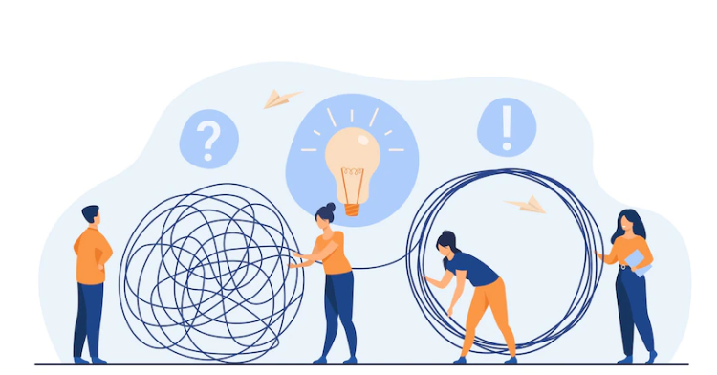
Challenges
OptiTrack Limitation
Rules Implementation
Integration of the Subsystems
Edge Cases
Communication with RefBox
26

Slide 28
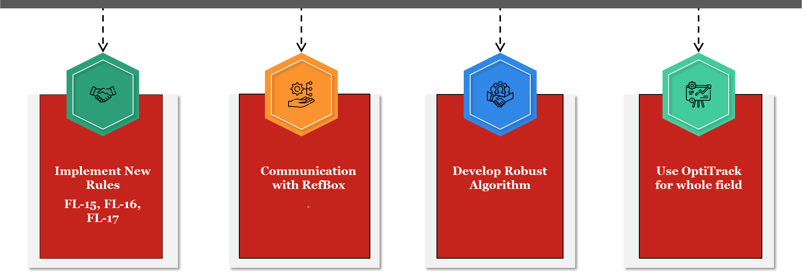
Future Work

Slide 29
شکریه
Terima Kasih
धन्यवाद
مرسی
THANK YOU!
DANKJE!
شكرًا
Teşekkürler

Slide 30
Question Answer Session

